Slide 1

Option 2a SubPro Implementation Proposal
Recommendations to Expedite the Next Round of Top-Level Domains

Slide 2

Background
About Us
Today’s panellists
Why did we develop this report?
What are we trying to achieve?
How can people get involved or share feedback?
Housekeeping for today’s session
brandregistrygroup.org/nextround
ICANN 76 – March 2023
Notes:
I think we can do without these slides and just have crews speak to them and Mike and I add colour

Slide 3
Current Situation
Evolving the namespace since 2000
SubPro work and the ODA Report
ICANN’s key recommendations in the ODA
Board ready to approve many recommendations?
So we asked ourselves the questions….
  What is missing?
  How can we introduce an agile mindset that expedites the program?
  Why an implementation focused model can help?
ICANN 76 – March 2023
Notes:
I think we can do without these slides and just have crews speak to them and Mike and I add colour

Slide 4
Current ICANN Proposal
In the Subsequent Procedures (SubPro) Operational Design Assessment (ODA) published on 12 December 2022, ICANN provided two options for moving forward with the next round;
Option 1 | Option 2
5-year implementation process Unlimited number of applications Processing largely automated Application fee - $270,000 Applications Open – 2028? | 18 month implementation process Unlimited number of applications – but processed in batches of 450 Processing largely manual Application fee - $240,600 Applications Open - 2025?
ICANN 76 – March 2023

Slide 5
Key Considerations
Concerns | Opportunities
Cost of Application Fees Fee structure unclear Cost of Program Implementation Delays to Application Window Accessibility Streamlining applications | Launching Program Quickly Launching Communications Campaigns Predictivity for Applicants Moving to support applicants beyond current remit
ICANN 76 – March 2023

Slide 6
Option 2a
Pillar #1
Restructure the Application Review Process
Pillar #2
Expedited Pre-Evaluation for Registry Service Providers
Pillar #3
Structured Application Prioritization Review
Pillar #4
Implement a Tiered Pricing Model
Pillar #5
Utilize Existing Systems to Create a Simple Platform
ICANN 76 – March 2023

Slide 7
Key Recommendations
Pillar #1
Restructure the Application Review Process
Background
2012 Application Round
Administrative
23 questions
Relatively simple answers regarding applicant and string
Technical
20 questions
Hundreds of pages of technical information
Financial
6 questions
Medium complexity financial statements and projections
ICANN 76 – March 2023

Slide 8
Key Recommendations
Pillar #1
Restructure the Application Review Process
Key Recommendation #1
Require applicants to only pay the base application fee and submit administrative question responses to enable the Initial Evaluation process to occur
Require applicants to submit their technical & financial responses after the prioritization draw and only if the applicant wishes for their application to be reviewed by ICANN
Allow applicants to submit documented proof that their RSP has passed pre-evaluation
ICANN 76 – March 2023

Slide 9
Key Recommendations
Pillar #1
Restructure the Application Review Process
Key Recommendation #2
Open a 6-month public comment period once the strings and applicants have been publicly released
Allow individuals or entities with standing to object on String Similarity, Community, Legal Rights or Limited Public Interest grounds as per 2012 round
Allow the Governmental Advisory Council (GAC) to provide their advice during this window
At the completion of this period, applicants will be made aware of any objections or advice regarding their application which will assist them to decide on their willingness to proceed.
ICANN 76 – March 2023

Slide 10
Key Recommendations
Pillar #1
Restructure the Application Review Process
Benefits
Allows for an expedited launch to the program
Does not penalize applicants that may have found out about this new gTLD opportunity late in the awareness campaign or have limited ICANN experience
Allows prospective applicants to build support for their application during the review process which can be important for certain types of community and geographic applications.
Reduces the overall complexity of the application portal
Provides adequate time for public comment, formal objection and GAC Advice
Provides applicants with enhanced predictability
ICANN 76 – March 2023

Slide 11
Key Recommendations
Pillar #2
Expedited Pre-Evaluation for Registry Service Providers
Background
In the 2012 round, the requirement to undertake a full review of the technical response for each application was an enormous lift for ICANN and caused delays for applicants.
The SubPro Report specifically identified Registry Services Provider (RSP) Pre-Evaluation as one of the key topics in its final report.
As part of a pre-evaluation, RSPs would have their full technical answers evaluated by ICANN prior to the application window. Applicants would simply assert that they were using a particular RSP and confirm that the Registry Services would be identical to those already approved by ICANN, signifying that the application should immediately pass technical review.
ICANN 76 – March 2023

Slide 12
Key Recommendations
Pillar #2
Expedited Pre-Evaluation for Registry Service Providers
Key Recommendation #3
Option 2a recommends that ICANN begin the process of pre-evaluating backend RSPs with the goal of announcing the opening of the Pre-Evaluation program at the ICANN 78 meeting in Hamburg, 2023.
This program should be available indefinitely for any RSP seeking to become pre-evaluated into the future.
This should commence immediately and as a priority initiative for the next round program launch.
ICANN 76 – March 2023

Slide 13
Key Recommendations
Pillar #2
Expedited Pre-Evaluation for Registry Service Providers
Benefits
Reducing the base application fee to correspond with ICANN's reduced workload
Streamlined technical review process to provide reliability and predictability to applicants
ICANN can publicize RSPs that have passed Pre-Evaluation, making it easier for applicants to find a provider
ICANN can use the largely defined processes and costs from their existing Material Subcontracting Arrangement Change documentation when implementing this program
ICANN 76 – March 2023

Slide 14
Key Recommendations
Pillar #3
Structured Application Prioritization Review
Background
Given the strong probability of receiving a volume of applications that exceeds ICANN’s ability to review all applications simultaneously, a process for prioritization will be required to provide some opportunity for ICANN to plan and provide applicants with visibility on the potential time to delegation.
The prioritization draw in 2012 was relatively successful given the circumstances, but learning from this – specifically process and early communication to applicants – is paramount for a successful next round.
ICANN 76 – March 2023

Slide 15
Key Recommendations
Pillar #3
Structured Application Prioritization Review
Key Recommendation #4
Option 2a recommends the creation of three separate prioritization draws with sequential numbering;
Draw 1 - IDN applications seeking an expedited review
Draw 2 - Non-IDN applications seeking an expedited review
Draw 3 - Applications electing to forgo expedited review (IDN or Non-IDN)
Option 2a also recommends prioritization of all IDNs and that ICANN immediately invite the first 450 applications from the prioritization draw to ‘Opt-In’ to submit their technical and financial responses and provide an 8-week window.
ICANN 76 – March 2023

Slide 16
Key Recommendations
Pillar #3
Structured Application Prioritization Review
Benefits
Sequential numbering gives applicants predictability and the ability to move faster if their application is ‘Simple’ and if others opt-out or have issues
Opt In process allows TLDs that want to slow down to do so
Easier processing capability for ICANN
ICANN 76 – March 2023

Slide 17
Key Recommendations
Pillar #4
Implement a Tiered Pricing Model
Background
Historically, ICANN has opted for a one-size fits all approach toward application fees;
Proof of Concept TLD Round (2000) = $50,000
Sponsored TLD Round (2004) = $45,000
Open TLD Round (2012) = $185,000*
* 2012 round - some applicants were required to pay additional fees in connection with certain processes, e.g. to respond to formal objections and/or community designation.
ICANN 76 – March 2023

Slide 18
Key Recommendations
Pillar #4
Implement a Tiered Pricing Model
Key Recommendation #5
Option 2a proposes a base application fee of USD 100,000 which would be paid by all applicants during the application submission period.
‘Complex’ applications may then be subject to additional fees that must be paid before their TLD could enter the contracting and delegation phases. This could include, but is not limited to, situations such as:
Third Party Objections (as per 2012 round)
Applicant Elected TLD Designations
  Community Priority
  Geographic
  Closed Generics (to be determined)
ICANN 76 – March 2023

Slide 19
Key Recommendations
Pillar #4
Implement a Tiered Pricing Model
Benefits
Avoids ’simple’ applications being disproportionately burdened with the extra costs ICANN incurs for ‘complex’ applications
Keeps the application fee from significant increases, providing opportunity for additional community participation
Ensures that ICANN’s costs are covered on TLDs that cause additional expense to process for any reason
Keeps the application fee achievable for smaller communities and developing regions that might not meet applicant support criteria
ICANN 76 – March 2023
Notes:
From subpro - ICANN org notes that there are a few reasons for this: 1) implementing the SubPro Final Report outputs, which includes ensuring that the appropriate systems, procedures, processes, and resources are all in place in time for the opening of the next application submission period–and ICANN | New gTLD Subsequent Procedures Operational Design Assessment (ODA) | 12 December 2022 | 11 to mitigate challenges faced in the past–will require considerable upfront cost; 2) inflation, including increased vendor costs; 3) added complexities in the recommendations versus the 2012 round; and, 4) the need to ensure that tools for applicant assistance and other resources are in place.

Slide 20
Key Recommendations
Pillar #5
Utilize Existing Systems to Create a Simple Platform
Background
In both Options 1 and 2 provided by ICANN from the ODA report, the development of the necessary systems and infrastructure is stated to cost over $400M.
Whilst it is acknowledged that there is significant work to be done by ICANN to facilitate the next round, a cost base of that size is alarming and requires a detailed analysis of opportunities to rationalise requirements and/or costs.
ICANN 76 – March 2023

Slide 21
Key Recommendations
Pillar #5
Utilize Existing Systems to Create a Simple Platform
Key Recommendation #6
A simplified system for application submission
Applicant Entity Verification
Further analysis of cost saving measures
ICANN 76 – March 2023

Slide 22
Key Recommendations
Pillar #5
Utilize Existing Systems to Create a Simple Platform
Benefits
Cost reduction for applicants
Agile approach to program delivery
ICANN 76 – March 2023

Slide 23
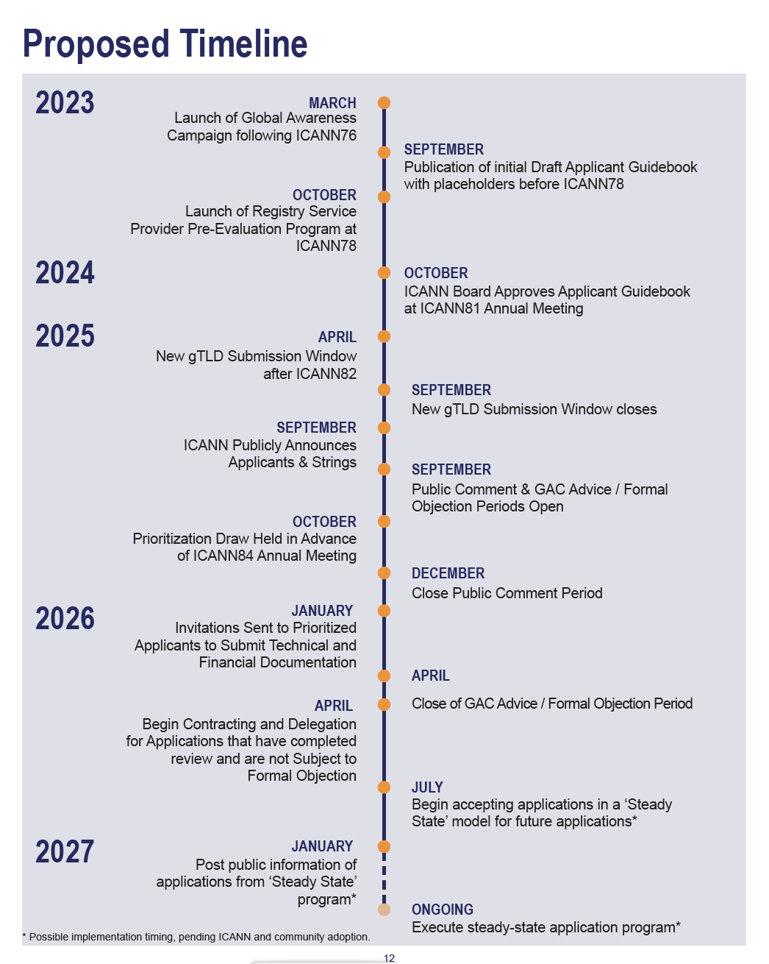
Proposed Timeline
ICANN 76 – March 2023

Slide 24
Still to be resolved
The intention of this report is to build on the proposed Option 2 and develop a clear and efficient path for ICANN and for applicants to expeditiously launch the next round in an agile and collaborative manner.
To that extent, we are aware that several program elements are yet to be resolved and that this report is not yet a complete solution for implementing the program. This includes topics such as;
Closed Generics
Auctions for Contention Management
ICANN Global Communications Strategy
Community Priority
Requirements for Letters of Credit
Managing unintended manipulation of the program
Board review of outstanding 38 issues.
ICANN 76 – March 2023

Slide 25
Q&A

Slide 26
Report Download - brandregistrygroup.org/nextround
Feedback – info@brandregistrygroup.org

